Slide 1
Mental Navigation in the Primate Entorhinal Cortex
Shervin Jahanbakhsh & Sean Conlon

Slide 2
Part 1 - Experimental Background

Slide 3
The Core Questions
How does the brian navigate without sensory input?
How is distance computed internally?
How does structure reduce behavioral error?
Notes:
What do we mean by “mental navigation”? We mean the brain can compute over a structured internal representation when there is no sensory input guiding it.
This internal representation is what we call a cognitive map. It’s not just a memory of individual locations or stimuli. It’s a representation of the relationships between them (e.g. distances, order, and structure).
If the brain has such a map, then it should be able to do three things
Navigate without seeing anything (solely relying on its internal map)
Generalize to new situations (leverage the structure of the internal map to understand unseen situations)
Reduce error (the internal representation should reduce error)
The paper shows all three of these claims directly, the rest of the talk is about how those claims show up in behavior, neural activity, and a simple computational model.
Transition - To make these questions precise, the first thing we need is a working notion of what we actually mean by a cognitive map.

Slide 4
Cognitive Maps
An internal representation of relationships between states
Encodes structure, not just stimulus-response pairs
Supports inference about novel situations
Notes:
Cognitive maps represent states and the relationships between them.
For example, the order, distance, and structure of states.
This is a deeper concept than a simple stimuli-response association
Because the cognitive map builds a world model, it supports inference and generalization by applying unseen stimuli/states to its learned world model.
Critically, this can be done without sensory input
Transition - Give this definition, the question becomes where in the brain can such a structured representation actually be implemented?

Slide 5
Why the Entorhinal Cortex?
Known for grid cells and path integration
Encodes spatial and abstract variables
Candidate substrate for cognitive maps
Notes:
The entorhinal cortex is a natural place to look for this kind of representation.
Contains grid cells and path integration which are known to solve the problem of tracking state through time and space (even without continuous sensory input)
Beyond this, EC neurons are known to encode abstract variables and relational structure, indicating the neural structures are more general than just navigation.
Taking these into consideration, the EC is a prime candidate for cognitive maps.
Transition - To test whether the EC supports cognitive maps, the authors designed a controlled navigation task with a monkey interacting with a visual display.

Slide 6
Experimental Setup
A monkey is seated in front of a screen
Given a joystick to control the movement of a dot along a line segment
Visual landmarks are displayed on the screen
Joystick speed is fixed, so distance is encoded by movement time
Objective - From a starting landmark, use the joystick to navigate to a target landmark.
Notes:
(bullet 1) In the experiment, the monkey is seated in front of a screen and interacts with the task using a joystick.
(bullet 2) The joystick controls the movement of a dot along a one-dimensional line segment displayed on the screen
(bullet 3) Along this line, visual landmarks are shown at fixed positions, providing spatial structure.
(bullet 4) The joystick moves the dot at a fixed speed, so the only way to control distance is by how long the joystick is held, making this a timing-based navigation task.
(bullet 5) On each trial, the monkey’s objective is to start from one landmark and use the joystick to navigate to the other.
Transition - With this setup, the key experimental mechanism is when visual landmarks are available and when they are removed.

Slide 7
Learning vs Mental Navigation
Learning Phase - Landmarks are visible during movement
The monkey learns landmark spacing and joystick dynamics
Mental Navigation (MNAV) Phase - Landmarks are not visible during movement
The monkey must navigate without visual feedback.
Notes:
(intro) The experiment is divided into two distinct phases
(bullet 1) Learning phase, all landmarks are visible to the monkey while it moves the dot using the joystick.
(bullet 2) This allows the monkey to learn both the relative spacing between landmarks and how joystick deflection maps onto movement on the screen
(bullet 3) Testing phase, landmarks now disappear during movement
(bullet 4) This task forces the monkey to rely on its internal cognitive map rather than visual feedback, testing whether the monkey can navigate using a cognitive map.
Transition - With the task structure and training in place, the first question is simply how well the monkeys perform when navigating without visual feedback.

Slide 8
Behavioral Performance
Accurate production of distances
Linear relationship: produced vs actual
High performance across sessions
Notes:
(bullet 1) Once trained, the monkeys were very accurate at producing the correct distances
(bullet 2) Across trials, the produced distanced scaled linearly with the actual distance between the start and target landmarks.
This means the monkeys are not just hitting a timed stereotyped interval. They are continuously scaling their response according to the underlying structure of the task.
This indicates the monkeys are navigating with an internal map rather than executing a learned motor routine.
(bullet 3) The high level of performance is stable across sessions, indicating that the animals have learned the task structure rather than relying on trial-and-error adjustments.
Transition - Beyond accuracy on trained trials, a stronger test of the representation is whether the monkeys can generalize to new, untrained conditions.

Slide 9
Generalization
Only half of the landmark pairs are trained
The remaining pairs are held out during training
The monkeys immediately generalize to new pairs during MNAV
Notes:
(bullet 1) Importantly the monkeys are not trained on all possible start-target landmark pairs
(bullet 2) Only about half the possible pairs are used during training, while the rest are held out for use during the mental navigation test
(bullet 3) When tested on these novel pairs, the monkeys immediately perform well, which shows that they are not memorizing specific movements but instead using a structured internal representation of the landmark relationships.
Transition - Having established that the behavior reflects a structured internal representation, the next step is to ask how this structure is reflected in neural activity.

Slide 10
Neural Recordings
Single-unit recordings in the entorhinal cortex
Analysis focused on the navigation epoch
No visual input during this period
Notes:
(bullet 1) To understand the neural basis of this behavior, the authors recorded the spiking activity from individual neurons (“single-units”) in the entorhinal cortex
(bullet 2) The analyses focus specifically on the navigation epoch, when the monkey is actively moving toward the target.
(bullet 3) Crucially, during this entire period there is no visual input, so any structure in the neural activity must be generated internally rather than driven by sensory cues.
Transition - Analysis of the neural recordings revealed three prominent patterns of activity during the navigation epoch.

Slide 11
Neural Signature 1 - Periodicity
Transient firing bumps
Period matches landmark spacing
Generated without sensory cues
Notes:
(bullet 1) One prominent feature of the neural activity is that many neurons show firing rates that change systematically as the monkey moves toward the target.
(bullet 2) In particular, firing rates often ramp with distance and show strong encoding near the time of joystick offset, when the monkey decides to stop.
(bullet 3) This pattern is different from classical timing tasks, where information is typically carried by the slope of the ramp or a fixed threshold, rather than by distance-specific activity at the end of the movement.
Transition - In addition to periodic activity, a second, complementary pattern in the neural responses was observed.

Slide 12
Neural Signature 2 - Ramping
Firing rate ramps with distance
Strong encoding near joystick offset
Distinct from classical timing ramps
Notes:
(bullet 1) A second pattern observed in the entorhinal cortex is ramping activity, where firing rates increase or decrease as a function of distance traveled.
(bullet 2) Importantly, this ramping strongly encodes distance near joystick offset, when the animal decides to stop moving.
(bullet 3) This differs from classical timing tasks, where information is often carried by the slope of the ramp or by reaching a common threshold, rather than by distance-specific activity at the end of the movement.
Transition - Beyond mean firing patterns, how trial-to-trial variability changes during navigation was also examined.

Slide 13
Neural Signature 3 - Variability
Trial-to-trial variability is not uniform
Variability is reduced near landmarks
This predicts improved behavioral accuracy
Notes:
(intro) The third pattern concerns variability rather than mean firing rates.
(bullet 1) Trial-to-trial variability in neural activity is not uniform over time, but instead shows systematic structure during navigation.
(bullet 2) In particular, variability is reduced near the internal landmark positions, which suggests an error-correcting mechanism.
(bullet 3) This reduction in neural variability naturally predicts improved behavioral accuracy, linking the neural dynamics directly to performance.
Transition - Putting these neural signatures together gives a coherent picture of how internal structure shapes activity during mental navigation.

Slide 14
Experimental Summary
Internal representation is structured
Neural activity with periodic and ramping dynamics coexist
Landmark structure reduces variability
Notes:
(bullet 1) Taken together, the experimental results point to a structured internal representation underlying mental navigation.
(bullet 2) Neural activity in the entorhinal cortex shows both periodic and ramping dynamics, indicating multiple complementary signals during navigation.
(bullet 3) Crucially, the structure associated with internal landmarks is linked to a reduction in neural variability, suggesting a functional role in improving behavioral accuracy.
Transition - The natural next question is what kind of circuit-level mechanism could give rise to all of these experimental observations.

Slide 15
Part 2 - Computational Model

Slide 16
Modeling Goal
Explain neural dynamics mechanistically
Account for reduced variability
Link neural activity to behavior
Notes:
(bullet 1) The goal of the model is not to reproduce every detail of the data, but to explain the key phenomena at a mechanistic level.
(bullet 2) Specifically, the model needs to account for the observed neural dynamics, including periodic and ramping activity.
(bullet 3) It also needs to explain why variability is reduced near landmarks.
Finally, the model should link these neural dynamics to the animals’ behavioral performance, rather than treating behavior as an afterthought.
Transition - A natural starting point for this kind of problem is a continuous attractor network, which is well suited for representing and updating an internal state over time.

Slide 17
Continuous Attractor Networks (CANs)
Stable low-dimensional manifold
The activity bump represents the state
The velocity input moves the bump
Notes:
(intro) Continuous attractor networks provide a natural way to represent a continuously varying internal state.
(bullet 1) Their activity lives on a low-dimensional manifold, typically expressed as a localized bump of activity.
(bullet 2) The position of this bump represents the current state of the system, and velocity inputs move the bump smoothly along the manifold.
(bullet 3) Because of this, continuous attractors are well suited for path integration problems like the one in this task.
Transition - To make that idea concrete, the model implements a continuous attractor using a specific recurrent network architecture.

Slide 18
CAN Architecture
1D ring topology
“Mexican-hat” recurrent connectivity
Left / right populations biased by velocity
Notes:
(bullet 1) In this model, the continuous attractor is implemented as a one-dimensional ring of neurons.
(bullet 2) Recurrent connectivity has a Mexican-hat structure, with local excitation and broader inhibition, which stabilizes a single localized bump of activity.
(bullet 2) The network is split into left- and right-biased populations, and velocity input asymmetrically biases these populations.
This asymmetry causes the activity bump to move around the ring in proportion to the velocity signal, implementing path integration.
Transition - Given this architecture, we can now describe how the network’s internal state is represented and evolves over time.

Slide 19
State Representation
Network state = bump phase
Phase tracks elapsed distance
Noise causes phase diffusion
Notes:
In this framework, the state of the network is summarized by the phase of the activity bump around the ring.
As the monkey moves, this phase advances, so the bump phase directly tracks the distance traveled.
When noise is present in the velocity input, it causes the bump phase to diffuse over time, which provides a natural source of timing and distance error.
Transition - To see what this representation implies for behavior, we can first look at how the network behaves in the absence of any landmark structure.

Slide 20
CAN Without Landmarks
Smooth bump drift
Noise accumulates continuously
Variability grows linearly with distance
Notes:
If we run the continuous attractor network without any landmark input, the behavior is very simple.
The bump phase still tracks elapsed distance through velocity integration, but it does so continuously and uninterrupted.
Because noise is present in the velocity input, the bump phase diffuses over time, and errors accumulate steadily.
As a result, variability in the represented distance grows monotonically with time or distance traveled.
Transition - To reduce this accumulated error, the model introduces an additional source of structure in the form of landmark neurons.

Slide 21
Landmark Neurons
Neurons that fire at specific phases
Driven externally during learning
Driven internally during recall
Notes:
To introduce structure into the model, the authors add landmark neurons that are selective for specific phases of the attractor.
During the learning phase of the task, these neurons are driven externally by visual landmarks.
After learning, when landmarks are no longer visible, the same neurons are driven internally by the attractor network itself, allowing the system to recall landmark locations endogenously.
Transition - The next step is to understand how this landmark structure is actually learned by the network.

Slide 22
Learning the Landmark Structure
Hebbian / Oja learning rule
Strengthen phased-matched inputs
External landmarks → Internal landmarks
Notes:
The connections between the attractor network and the landmark neurons are learned using a simple Hebbian rule, specifically Oja’s rule.
During learning, inputs from attractor neurons whose phases align with the external landmark are selectively strengthened.
As a result, the network learns to reproduce the landmark signal internally, so external landmarks during training become internal landmarks during mental navigation.

Slide 23
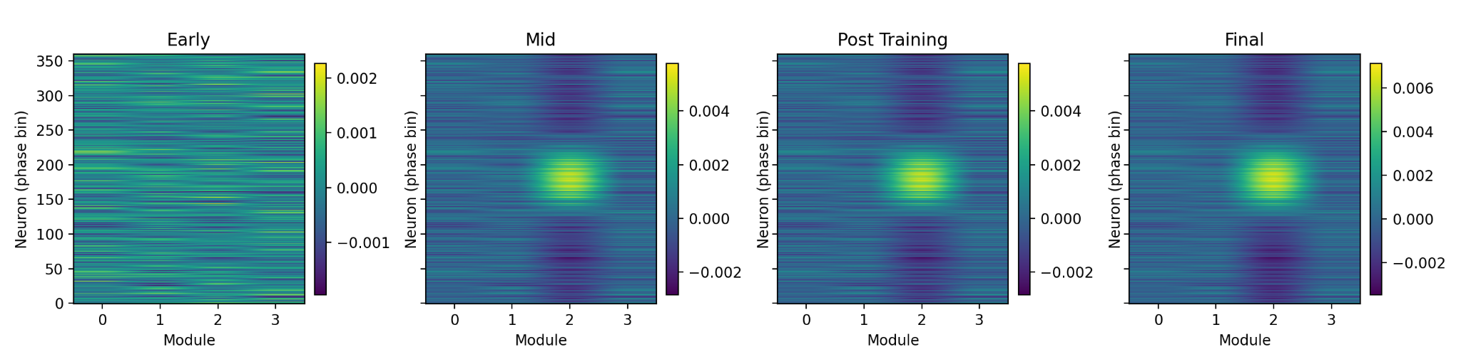
Landmark Neuron - CAN Synaptic Weights
Reproduction of Fig. 4b in the paper
Notes:
Transition - Once this landmark structure has been learned, the key question is how it changes the dynamics of the attractor during navigation.

Slide 24
CAN With Internal Landmarks
Landmark input stabilizes the bump
The bump’s motion slows near landmarks
Produces reset-like dynamics
Notes:
Once internal landmarks are learned, they start to influence the dynamics of the attractor.
When the bump approaches a landmark phase, landmark input locally stabilizes the activity pattern.
This stabilization causes the bump’s motion to slow down near landmarks, making it less sensitive to noise.
The result is a reset-like dynamic, where accumulated error is partially corrected at each landmark rather than continuously accumulating.
Transition - This difference in dynamics shows up most clearly when we look at how variability scales with distance.

Slide 25
Variability Scaling
No landmarks - Error grows linearly
With landmarks - Error grows sublinearly
With landmarks behavior matches the monkey’s
Notes:
We can now look at how these dynamics affect error accumulation.
In the absence of landmarks, error grows linearly with distance, because noise is integrated continuously over time.
When internal landmarks are present, error grows sublinearly, since the reset-like dynamics periodically reduce accumulated error.
This sublinear growth of error closely matches what is observed in the monkeys’ behavior, providing a direct link between the model dynamics and performance.

Slide 26
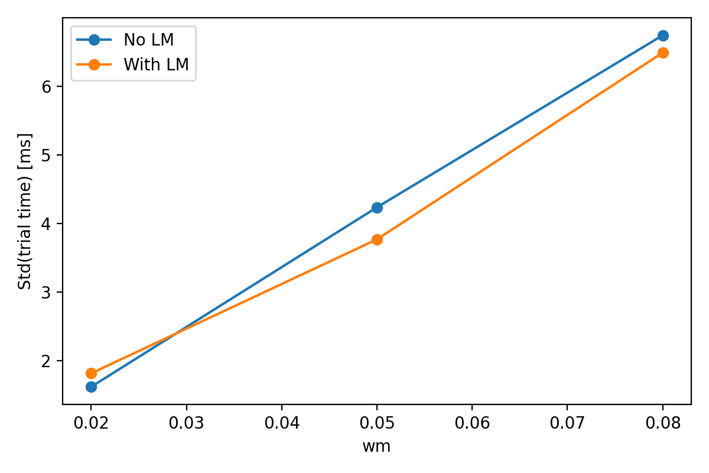
Variation in Duration as a function of Input Noise
Reproduction of Fig. 4d in the paper
Notes:
Transition - Looking more closely at this variability reveals that it is not just reduced overall, but structured in time.

Slide 27
Periodic Variability
Variability oscillates in time
Period of the oscillations equals the landmark spacing
This is predicted by the model and seen in neurons
Notes:
A striking prediction of the model is that variability should not just be reduced on average, but should fluctuate periodically over time.
Specifically, variability oscillates with a period that matches the spacing between landmarks.
This periodic modulation arises from the reset-like dynamics introduced by internal landmarks.
Importantly, the same periodic structure in variability is observed in the neural data, providing a strong link between the model’s predictions and the recorded activity in entorhinal cortex.
Transition - The final step is to ask whether these neural and model-based effects actually explain the monkeys’ behavior.

Slide 28
Linking the Model to Behavior
Bayesian observer models
Landmark-reset model fits better
Mechanistic explanation of performance
Notes:
To connect the model more directly to behavior, the authors fit Bayesian observer models to the monkeys’ performance.
These models differ in whether they assume continuous error accumulation or periodic resets associated with internal landmarks.
The landmark-reset model provides a significantly better fit to the behavioral data.
This shows that the reset-like dynamics in the neural model offer a concrete, mechanistic explanation for how the monkeys achieve their level of performance.
Transition - Taken together, this allows us to ask what aspects of the experimental data the model can explain in a unified way.

Slide 29
What the Model Explains
Periodic neural activity
Ramping distance signals
Reduced behavioral variability
Notes:
Stepping back, the model provides a unified explanation for several key experimental findings.
It accounts for the periodic neural activity associated with internal landmarks.
It also explains the ramping signals that encode distance during navigation.
And importantly, it explains why behavioral variability is reduced when landmark structure is available, linking neural dynamics directly to performance.
Transition - With that mechanistic picture in place, it’s worth stepping back to consider what this might imply beyond this specific task.

Slide 30
Broader Implications
Mental counting and rehearsal
Abstract cognitive navigation
General principle for structured computation
Notes:
Although this work focuses on a navigation task, the underlying mechanism is likely more general.
Tasks like mental counting or rehearsal also involve moving through structured internal states without sensory input.
More broadly, this suggests that continuous attractor dynamics combined with internal landmarks may provide a general principle for structured computation in the brain, beyond physical space.
Transition - To wrap up, I’ll summarize the main ideas and takeaways from the work.

Slide 31
Summary
Memory actively shapes dynamics
Structure reduces uncertainty
Cognitive maps are computational tools
Notes:
The key takeaway from this work is that memory is not just a static store of information, but actively shapes neural dynamics during computation.
By imposing structure on those dynamics, internal landmarks reduce uncertainty and improve performance.
In this sense, cognitive maps should be thought of not just as representations, but as computational tools that the brain uses to perform reliable internal operations.

